Slide 1
Quantum Computing
CVSN Reddy
RV University

Slide 2
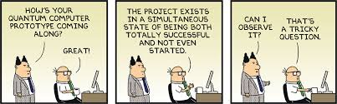
Quantum computing

Slide 3
Introduction
What is a quantum computer?
A quantum computer is a machine that performs calculations based on the laws of quantum mechanics, which is the behavior of particles at the sub-atomic level.

Slide 4
What is quantum computing
Quantum Computing refers to the use of quantum mechanical phenomena such as superposition and entanglement to perform computation. To understand quantum phenomena, it’s important to understand qubit, the unit of quantum information, and the concepts of superposition and entanglement.

Slide 5
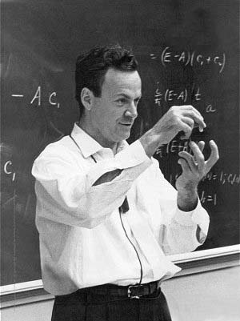
Introduction
“I think I can safely say that nobody understands quantum mechanics” - Feynman
1982 - Feynman proposed the idea of creating machines based on the laws of quantum mechanics instead of the laws of classical physics.
1985 - David Deutsch developed the quantum turing machine, showing that quantum circuits are universal.
1994 - Peter Shor came up with a quantum algorithm to factor very large numbers in polynomial time.
1997 - Lov Grover develops a quantum search algorithm with O(√N) complexity

Slide 6
Quantum MECHANICS
CVSN Reddy
Dayananda Sagar University

Slide 7
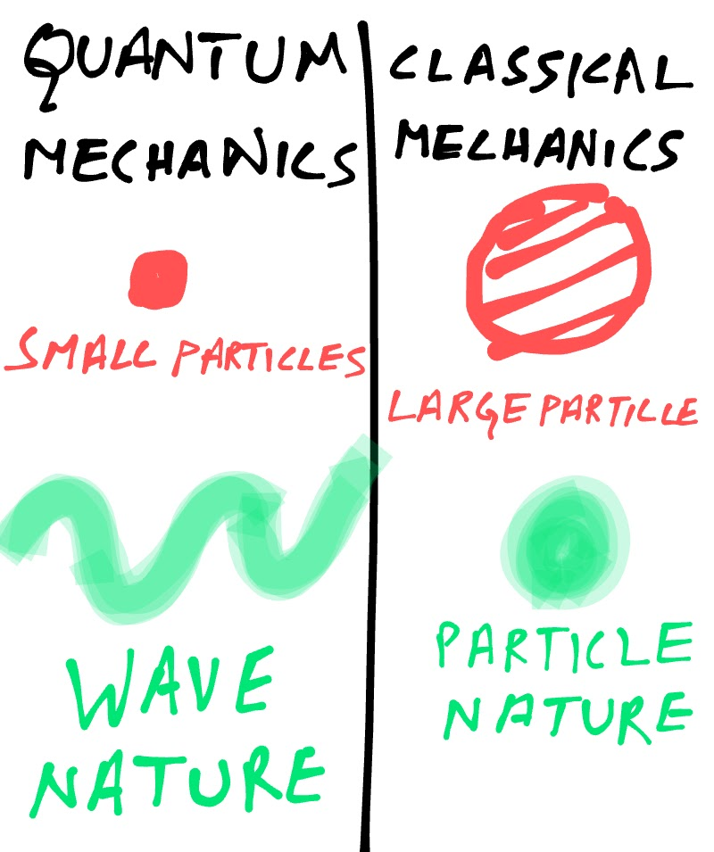
Quantum mechanics is a study involving particles at atomic and subatomic levels such at electrons

Slide 8
Quantum mechanics
Quantum mechanics is different from classical mechanics, which describes the behavior of macroscopic particles or in simple terms the particles we can see through our eyes.
The laws of quantum mechanics are different from classical mechanics, making it hard to visualize and understand.
In our normal physical world we take the position and state of object to be well defined and independent of other objects, which is exactly opposite to the laws of quantum mechanics
Quantum particles do not have specific position or state, but they are described mathematically, using a wave-function (mathematical representation of a wave)
The wave-function of a particle can give us the probability of finding a particle at a point
When we find the particle at a point, the wave-function collapses at that point
The barrier between the quantum world and physical world is measurement, the moment we make a measurement wave-function shifts to a particle
The gap in our knowledge is that we do not know how a widely spread wave collapse into a localized particle, after we make measurement at a point

Slide 9
Laws of quantum mechanics
The counterintuitive nature of quantum mechanics lies in the most fundamental laws of quantum mechanics, the fundamental laws are-
1-Superposition
2-Tunneling
3-Entanglement
4-Hisenburg uncertainty principle
5-Energy quantization

Slide 10
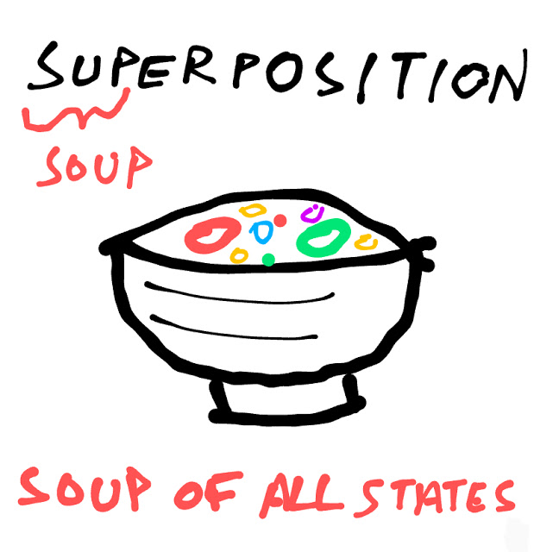
Superposition

Slide 11
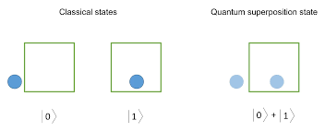
superposition

Slide 12
Superposition
We can also find the probability of finding a particle from its wave-function at a particular point
As the wave-function is a combination of various other waves for different states, it can be said that these is some probability of finding a particle in every possible state
hence the particle is existing in all possible states at the same time

Slide 13
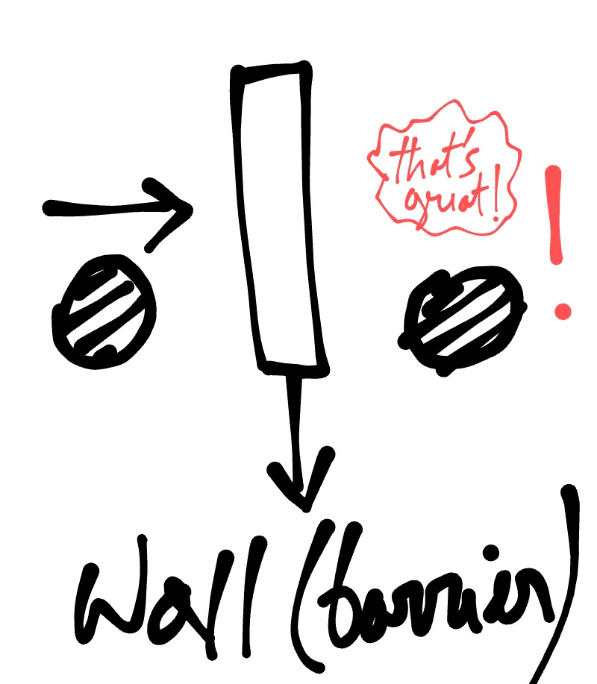
Quantum tunnelling

Slide 14
Quantum tunnelling
Quantum tunneling is a principle in quantum mechanics, allowing quantum particles to cross a barrier, by going through the barrier, or tunneling through the barrier
This can be visualized, by a macroscopic example of a ball (particle) and a wall (barrier)
According to classical physics, if we throw the ball toward the wall, it will bounce back
But quantum mechanics tells us, that ball can even be found on the other side of the wall

Slide 15
Quantum Tunnelling
Before the barrier, the wave-function is having a high amplitude, so there are good chances of finding the particle before the barrier
Inside the barrier- the wave-function decreases until the barrier ends, so the chance of finding the particle at the beginning of barrier are higher that where the barrier ends
After the barrier- the wave function now remains at its decreased value, meaning there is a small chance of finding the particle at the other side of barrier

Slide 16
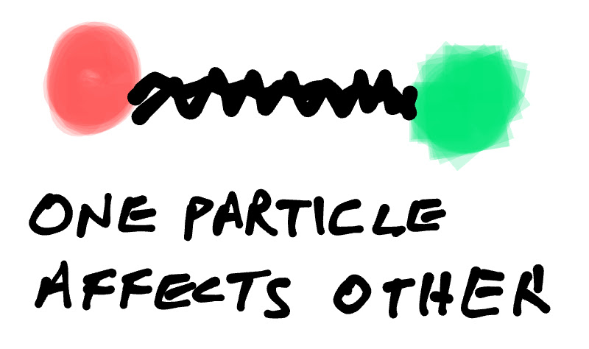
Quantum entanglement

Slide 17
Entanglement https://youtu.be/OefsPBDOcFE
Quantum Entanglement defines the relation between two particles separated by a distance. This distance could be as small as one centimeter or thousands of light years. The relation is defined by the interaction between these two particles. For example, when two particles are entangled, one particle will be observed spinning upward, and the other particle will be spinning downward. This means that they possess properties correlating each other.
When the particles are not entangled, they possess individual identities. When they become entangled, they lose their individual identities. Now, they have a single identity that defines both of them. The interesting phenomenon is that any change in one particle reflects the effect in the other particle irrespective of the distance between them. Moreover, once the entanglement has been established, it will stay there irrespective of the distance. The particle seems to know about the other particle, even if they are separated by a large distance.

Slide 18
Relationships among data - Entanglement
Entanglement is the ability of quantum systems to exhibit correlations between states within a superposition.
Imagine two qubits, each in the state |0> + |1> (a superposition of the 0 and 1.) We can entangle the two qubits such that the measurement of one qubit is always correlated to the measurement of the other qubit.

Slide 19
Quantum entanglement
The phenomenon of quantum entanglement allows one particle to affect the state of another entangled particle, depending on how first particle is measured
Quantum entanglement works regardless of the distance between the entangled particles
Suppose there are 2 entangled particles, and we measure their spins (or angular momentum)
if we measured first particle’s spin to be spin up
the second particle’s spic will certainly be spin down
if first particle’s spin was spin down
the second particle’s spin will be certainly spin up

Slide 20
Quantum entanglement
It seems that there is a communication taking place between the particles, as if the first particle is telling the second particle, what your spin should be
Entanglement works even if particles are astronomically far away, this seemed there is a faster than light communication between them (not allowed in Einstein’s theory of relativity)
Einstein didn’t liked entanglement, so he called it ‘spooky action at a distance
Mathematically we can explain quantum entanglement, and say it is not a faster than light communication.

Slide 21
Layman’s Terms
1- Y= -X is a wave-function, defining spins, for 2 entangled particles X and Y
2- if the spin of particle X is spin up or X=1
3- spin of Y is, Y= -(1) = -1 or spin down
4- if X= -1 (spin down), then Y= -(-1)= 1 (spin up)

Slide 22
Quantum entanglement
1- Consider 2 particles with different wave functions(defining their respective states)
2- These particles interact with each other
3- After interaction there is only 1 wave-function for both
4- The states of the particles will be defined by this single wave-function
5- Measurement of the state of first particle using this wave-function, changes the wave-function (defining the state of second particle), so state of second particle is affected

Slide 23
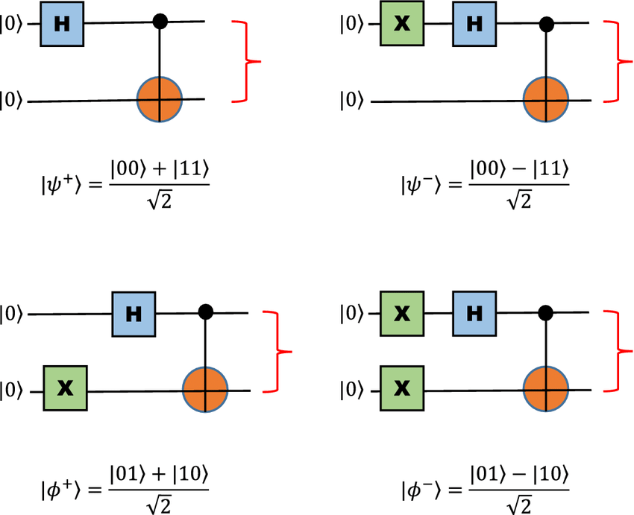
Quantum entanglement – bell states

Slide 24
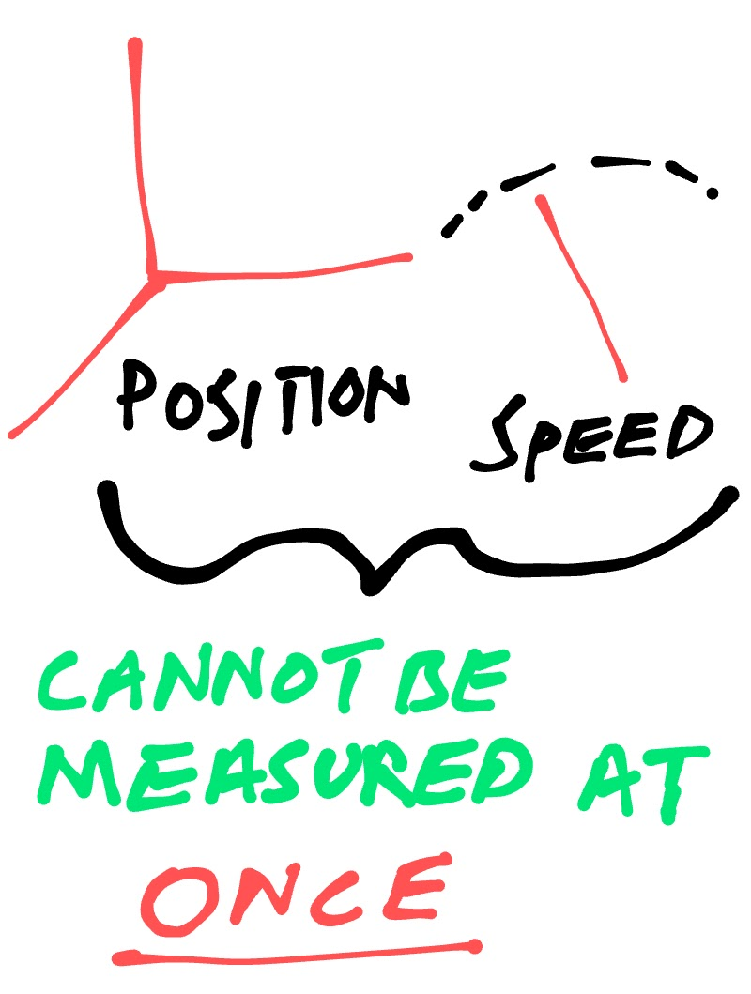
Hinesburg’s uncertainty principle Hinesburg’s uncertainty principle says that you cannot know or measure the position and momentum of a particle accurately at the same time

Slide 25
Hinesburg’s uncertainty principle
wave-function of a particle contains all information about its position and momentum
The amplitude squared tells the position and wavelength tell the momentum
If we fix the wavelength, we get a sine wave
We square this wave to find the probability distribution for particle’s position
We get a wave with constant amplitude, stretching to infinity on both sides
Meaning that particle can be found anywhere in this universe, or we are completely uncertain about particle’s position

Slide 26
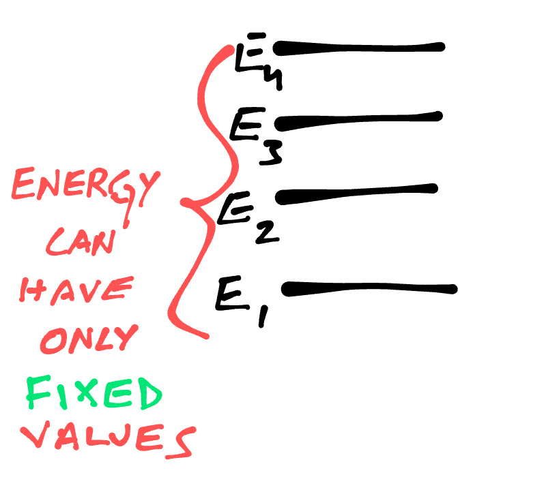
Energy quantization

Slide 27
Energy quantization
Suppose an atom is excited with certain energy
Electrons of an excited atom moves to higher energy levels
When these electrons come back to their original energy levels, they emit lights
These lights are of certain wavelengths only
This indicates that only a fixed amount of energy is absorbed and emitted by atoms
Thus, energy in an atom’s energy level only has certain discrete values.

Slide 28
Quantum Physics for Quantum computing
https://www.youtube.com/watch?v=Usu9xZfabPM&list=PLtc7EtOn0ajE2mGVYxFdyy9l3IuuO2Q5-&index=13&t=0s

Slide 29
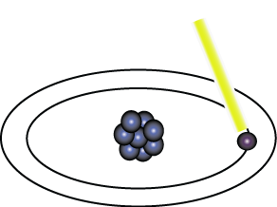
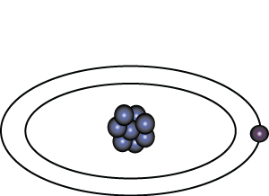
Representation of Data - Qubits
A bit of data is represented by a single atom that is in one of two states denoted by |0> and |1>. A single bit of this form is known as a qubit
A physical implementation of a qubit could use the two energy levels of an atom. An excited state representing |1> and a ground state representing |0>.
Light pulse of frequency λ for time interval t
Excited State
Ground State
Nucleus
Electron
State |0>
State |1>

Slide 30
Representation of Data - Superposition
A single qubit can be forced into a superposition of the two states denoted by the addition of the state vectors:
|ψ> = α |0> + α |1>
Where α and α are complex numbers and |α | + | α | = 1
1
2
2
2
1
2
1
2
A qubit in superposition is in both of the states |1> and |0 at the same time

Slide 31
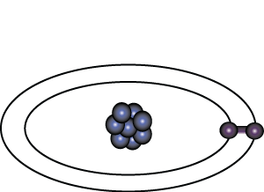
Representation of Data - Superposition
Light pulse of frequency λ for time interval t/2
State |0>
State |0> + |1>
Consider a 3 bit qubit register. An equally weighted superposition of all possible states would be denoted by:
|ψ> = |000> + |001> + . . . + |111>
1
1
1
√8
√8
√8

Slide 32
Quantum measurement
At first glance, a coin flip may seem like an example of this kind of indeterminacy, but its uncertainty has nothing to do with quantum physics. An ordinary coin is definitely heads or tails under your hand after a flip; we just don’t know which one until we peek at it. If we are very careful to control for the gusto of our flip, to arrange the air currents just so, and to account for the microscopic bumps on the coin, we could keep track of how the coin rotates, bounces and lands. With perfect information, we could conceivably know the result of the flip without looking at the coin.
Furthermore, after a single coin flip, the 50-50 split collapses when you look at the coin and learn the outcome. Similarly, once you make a quantum measurement, you’re left with just one of the possible results—a situation that is often called ”the collapse of the wavefunction” or simply “collapse.”

Slide 33
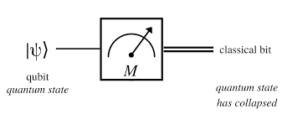

Slide 34
Quantum gates
CVSN Reddy
Dayananda Sagar University

Slide 35
Quantum Gates
Quantum Gates are similar to classical gates, but do not have a degenerate output. i.e. their original input state can be derived from their output state, uniquely. They must be reversible.
This means that a deterministic computation can be performed on a quantum computer only if it is reversible. Luckily, it has been shown that any deterministic computation can be made reversible.(Charles Bennet, 1973)

Slide 36
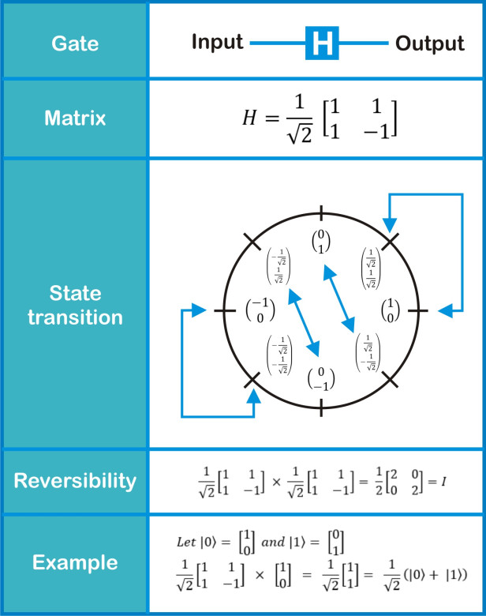
Hadamard gate is a very useful gate which is used to create superpositions. By giving a fundamental quantum state ( |0> or |1> ) to the Hadamard gate we can get superposed states.

Slide 37
Quantum Gates - Hadamard
Simplest gate involves one qubit and is called a Hadamard Gate (also known as a square-root of NOT gate.) Used to put qubits into superposition.
H
H
State |0>
State |0> + |1>
State |1>
Note: Two Hadamard gates used in succession can be used as a NOT gate

Slide 38

The NOT gate

Slide 39
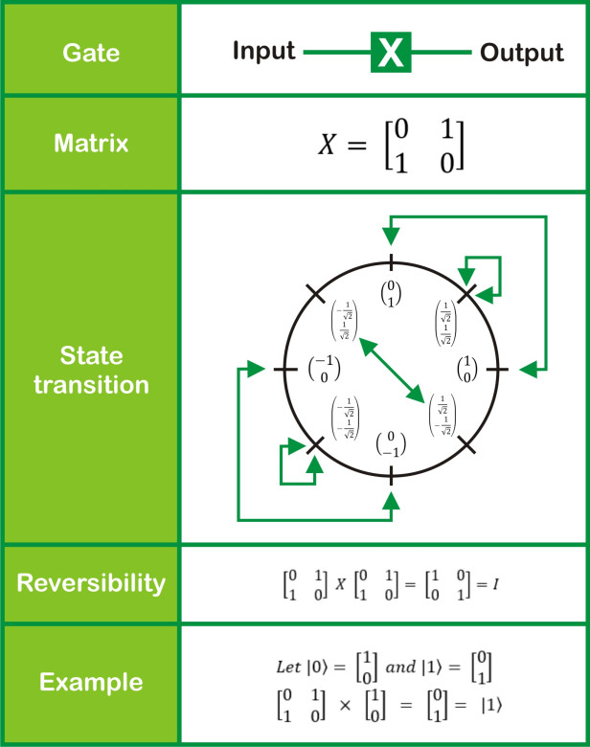
Pauli X Gate

Slide 40
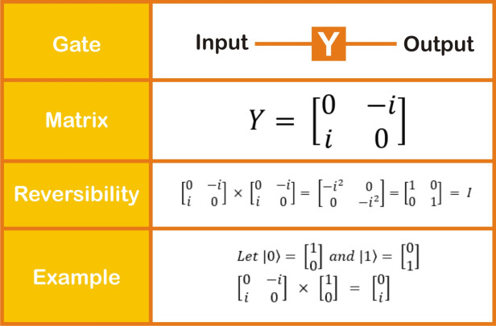
Pauli Y Gate

Slide 41
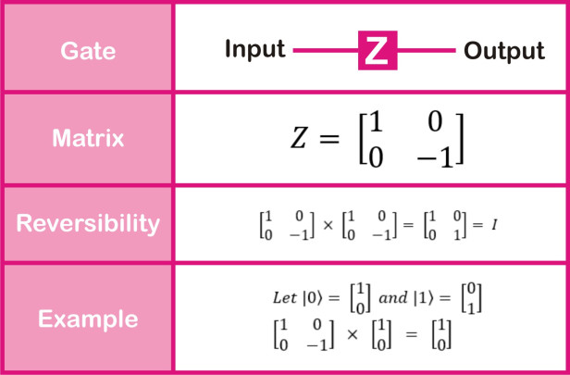
Pauli Z Gate

Slide 42
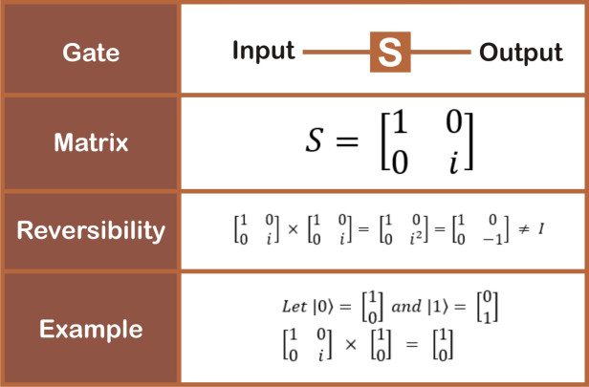
s gate

Slide 43
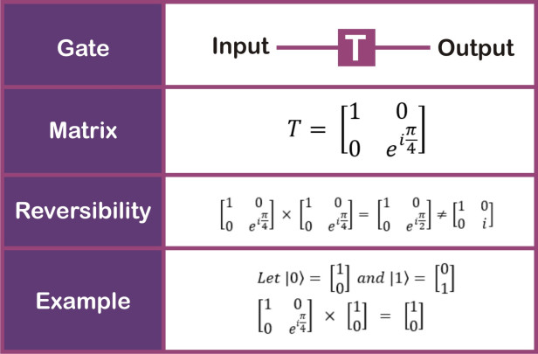
T GatE

Slide 44
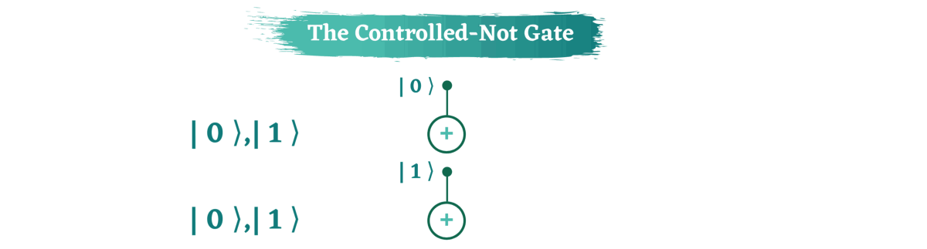
Controlled Not gate

Slide 45
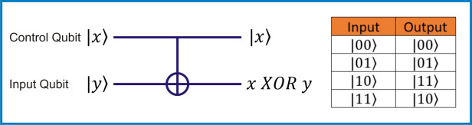
CNOT Gate

Slide 46
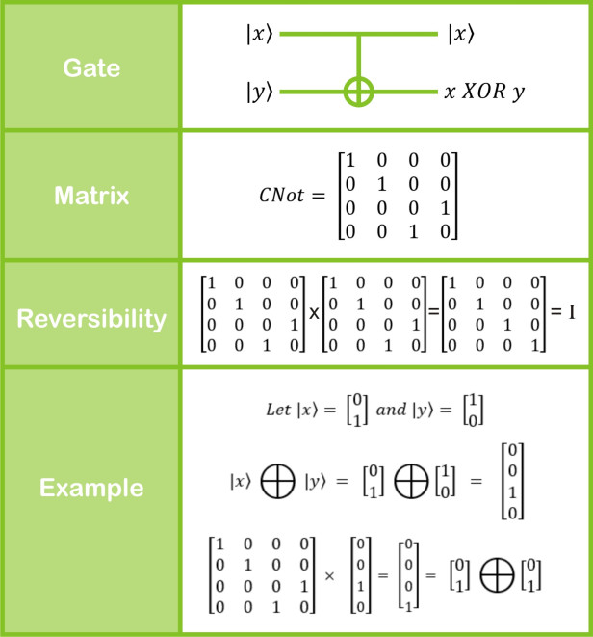
CNOT Gate

Slide 47
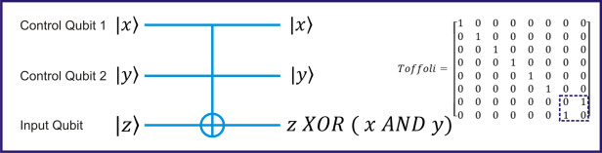
Toffoli Gate or CCNOT gate

Slide 48
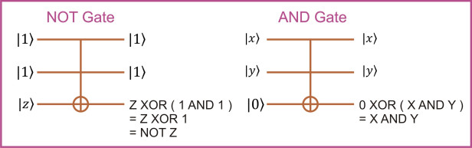
Toffoli gate => Quantum equivalent of a universal logic gate

Slide 49
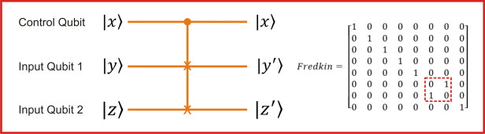
Controlled swap gate

Slide 50
Quantum Gates - Controlled Controlled NOT (CCN)
A gate which operates on three qubits is called a Controlled Controlled NOT (CCN) Gate. Iff the bits on both of the control lines is 1,then the target bit is inverted.
Input
Output
A | B | C | A’ | B’ | C’
0 | 0 | 0 | 0 | 0 | 0
0 | 0 | 1 | 0 | 0 | 1
0 | 1 | 0 | 0 | 1 | 0
0 | 1 | 1 | 1 | 1 | 1
1 | 0 | 0 | 1 | 0 | 0
1 | 0 | 1 | 1 | 0 | 1
1 | 1 | 0 | 1 | 1 | 0
1 | 1 | 1 | 0 | 1 | 1
A - Target
A’
B - Control 1
B’
C - Control 2
C’

Slide 51
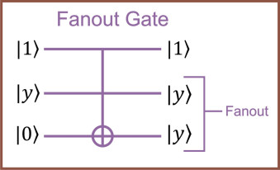
FANout

Slide 52
A Universal Quantum Computer
The CCN gate has been shown to be a universal reversible logic gate as it can be used as a NAND gate.
A - Target
A’
Input
Output
A | B | C | A’ | B’ | C’
0 | 0 | 0 | 0 | 0 | 0
0 | 0 | 1 | 0 | 0 | 1
0 | 1 | 0 | 0 | 1 | 0
0 | 1 | 1 | 1 | 1 | 1
1 | 0 | 0 | 1 | 0 | 0
1 | 0 | 1 | 1 | 0 | 1
1 | 1 | 0 | 1 | 1 | 0
1 | 1 | 1 | 0 | 1 | 1
B - Control 1
B’
C - Control 2
C’
When our target input is 1, our target output is a result of a NAND of B and C.

Slide 53
Quantum Circuits
Half Adder: Specific (reduced) design
|x₁⟩
|x₁⟩
CNOT
|x₀⟩
C²NOT (Toffoli)
sum
|y⟩
|y⟩ ⊕ carry

Slide 54
Quantum teleportation
CVSN Reddy
Dayananda Sagar University

Slide 55
Quantum teleportation protocol
Basically, Quantum teleportation transfers the quantum state of one particle onto another, identical particle, and at the same time erases the state in the original. Ideally it can be seen as if the original particle has been moved to the position of the identical particle. That transport of the movement of the particle has not really happened but to all appearances it might as well have.
However, this works even if you do not know what information you are sending that is, what the quantum state of the original particle actually is. That’s important because making a measurement on an unknown quantum signal can disturb and alter it.
Teleportation of a quantum state uses the phenomenon of quantum entanglement as a means of transmission. The phenomenon that when two or more particles are entangled, their quantum states are interdependent, no matter how far apart they are. In effect, they act as a single quantum object, described by a single wave function the mathematical construct that encodes all the quantum properties of the object.

Slide 56
Quantum teleportation protocol
What is quantum teleportation?
This may sound like science fiction, but it’s a real method that involves transmitting data wholly in quantum form. The approach relies on a quantum phenomenon known as entanglement.
Quantum teleportation works by creating pairs of entangled photons and then sending one of each pair to the sender of data and the other to a recipient. When Alice receives her entangled photon, she lets it interact with a “memory qubit” that holds the data she wants to transmit to Bob. This interaction changes the state of her photon, and because it is entangled with Bob’s, the interaction instantaneously changes the state of his photon too.
In effect, this “teleports” the data in Alice’s memory qubit from her photon to Bob’s. The graphic below lays out the process in a little more detail:

Slide 57
Quantum teleportation protocol
Quantum teleportation protocol
The protocol for Alice to send a qubit, in an unknown arbitrary state, to Bob is as follows:
The bell basis state, 00_{B}, is generated.
One of the qubits is given to Alice and the other qubit is given to Bob. Alice and Bob can then be spatially separated as much as they want.
Alice entangles the shared qubits with the qubit she wants to send. This is achieved by applying a CNOT gate to her two qubits followed by applying the Hadamard gate to the qubit she wants to send.
Alice performs a measurement, in the standard basis, of her two qubits.
Alice sends the result of her measurement to Bob over a classical communication channel. (Note: this introduces a time delay to prevent information being transmitted instantaneously.)
Depending on the received result, Bob applies different single qubit gates to obtain the qubit Alice wanted to send.
Specifically: if 00 is received the identity gate is applied, if 01 is received the NOT gate is applied, if 10 is received the phase flip gate is applied and if 11 is received the NOT gate is applied followed by application of the phase flip gate.

Slide 58
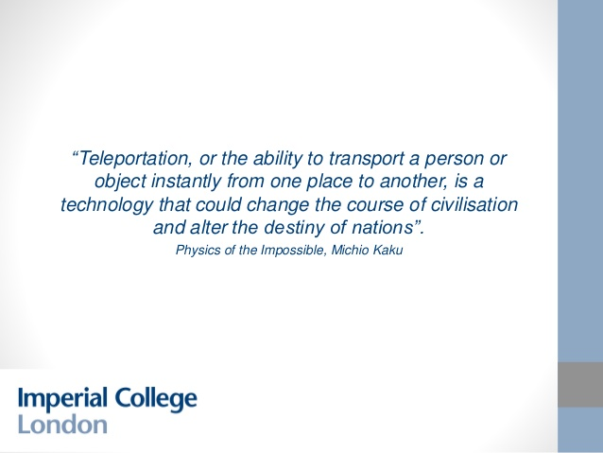

Slide 59
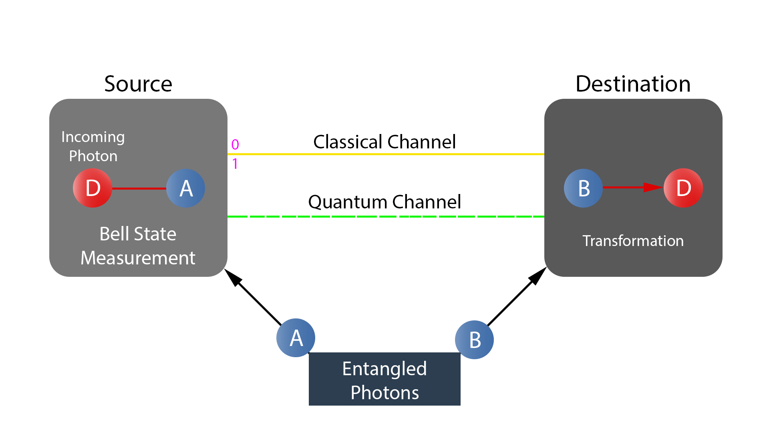
Quantum teleportation protocol

Slide 60
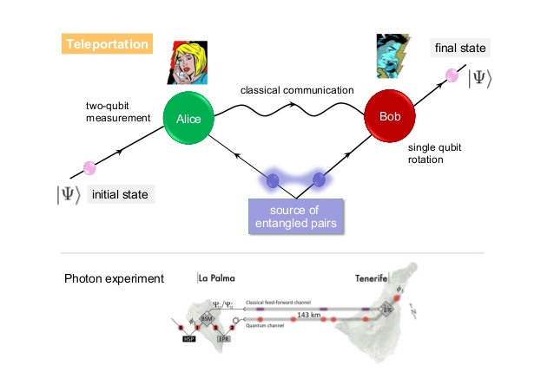

Slide 61
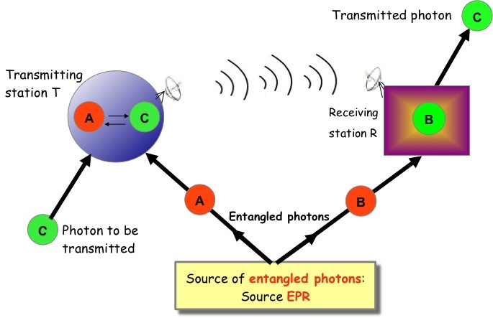
Quantum Teleportation

Slide 62
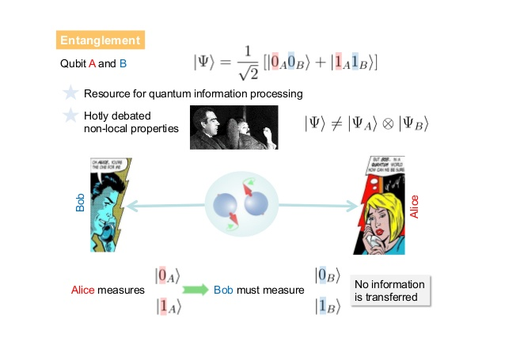

Slide 63
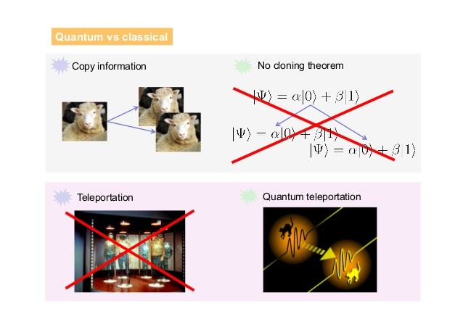

Slide 64
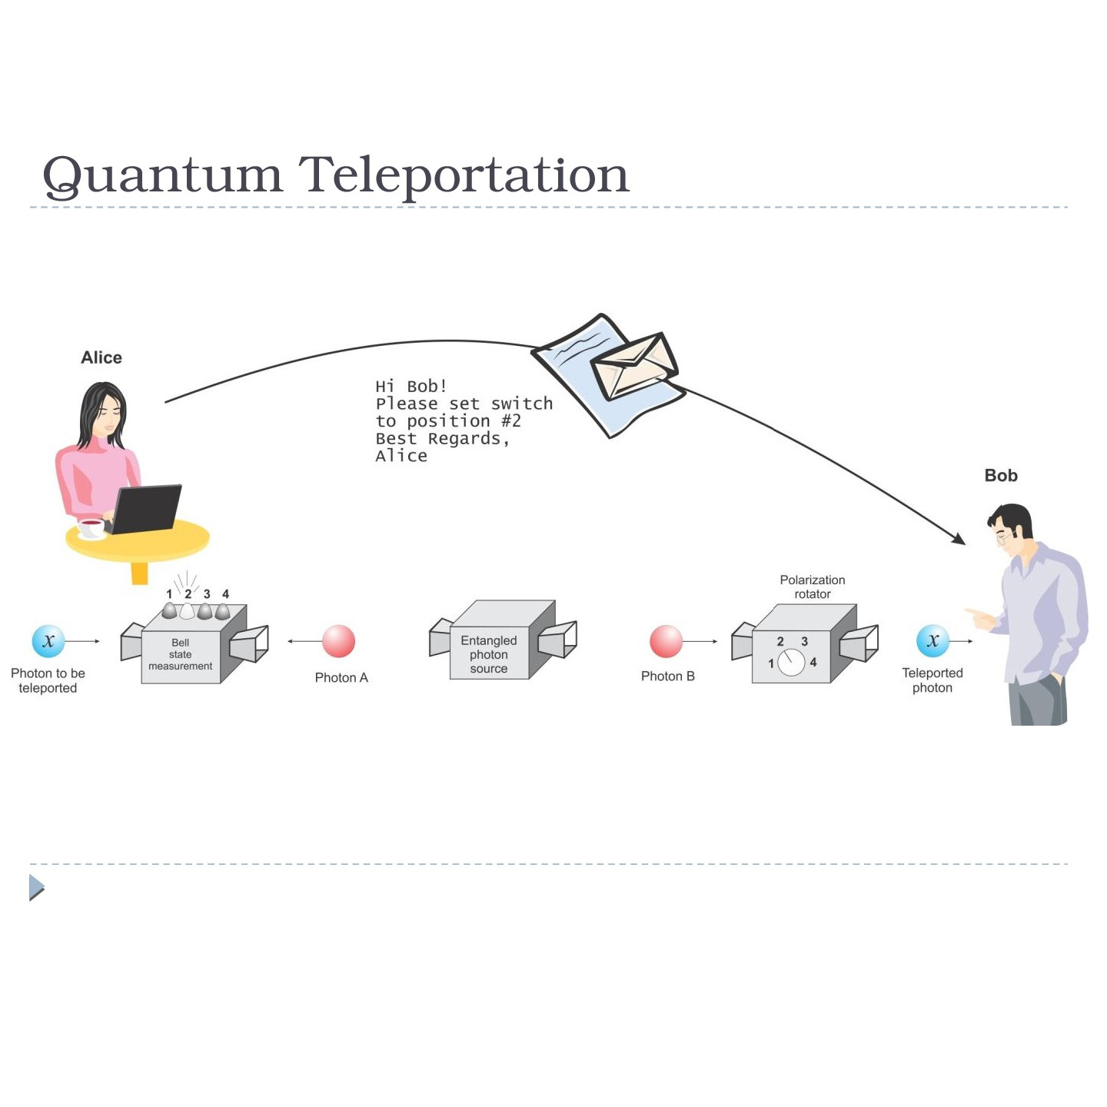

Slide 65
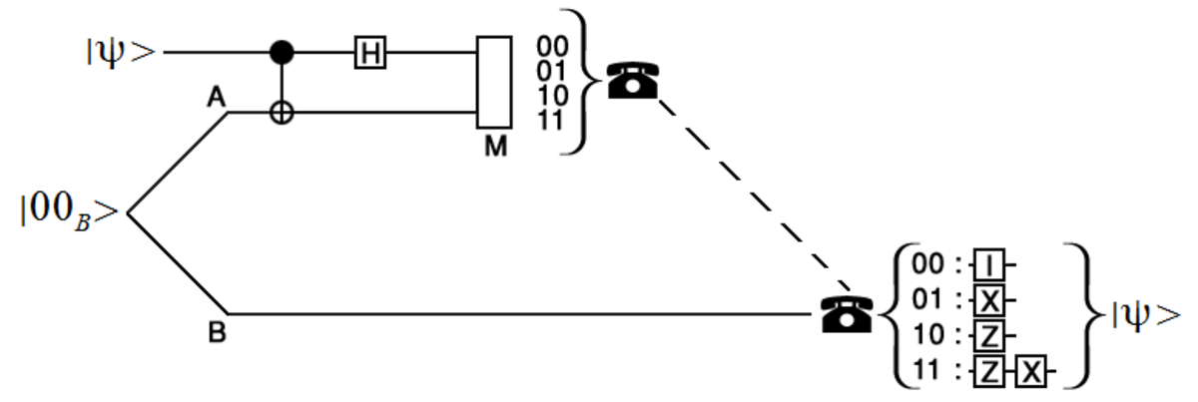

Slide 66
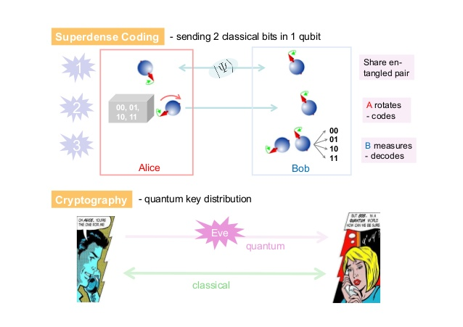
Superdense coding

Slide 67
Quantum algorithms
CVSN Reddy
Dayananda Sagar University

Slide 68
Quantum Supremacy
In 2012, Professor John Preskill coined the term “quantum supremacy” to describe the point when quantum computers become powerful enough to perform some computational task that classical computers could not do in a reasonable timeframe.
Quantum supremacy refers to quantum computers being able to solve a problem that a classical computer cannot.

Slide 69
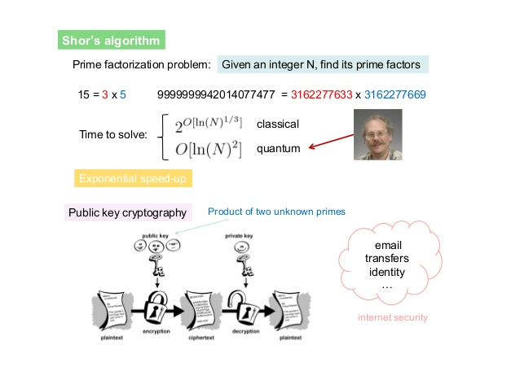
Shor’s algorithm

Slide 70
Shor’s Algorithm
Shor’s algorithm shows (in principle,) that a quantum computer is capable of factoring very large numbers in polynomial time.
The algorithm is dependant on
Modular Arithmetic
Quantum Parallelism
Quantum Fourier Transform

Slide 71
The Quantum Fourier Transform and Quantum Fourier Sampling
One of the most basic building blocks for quantum algorithms is the quantum Fourier transform (QFT) algorithm. The Fourier transform, a critical step in many classical calculations and computations, is an operation that transforms one representation of a signal of interest into a different representational form. The classical Fourier transform turns a signal represented as a function of time into its corresponding signal represented as a function of frequency.
This transformation is reversible via the inverse Fourier transform, so involves no information loss—a key requirement for any operation on a quantum computer. Concretely, the input is an N-dimensional vector with complex entries (a₁, a₂, …, a_{N}), and the output is an N-dimensional vector with complex entries (b₁, b₂, …, b_{N}) which is obtained by multiplying the input vector with the N × N Fourier transform matrix.

Slide 72
The best known algorithm for factoring prime numbers on a classical (non-quantum) computer requires an amount of time that is basically exponential with the size of NN. This is why Shor's Algorithm is considered important--a quantum computer running it would only require polynomial (as opposed to exponential) time. Since the security of the popular RSA cryptosystem is based on the difficulty of prime factorization, Shor's Algorithm has attracted a lot of interest from the privacy and data security communities.
Shor's Algorithm is an algorithm designed to be run on a quantum computer. The algorithm takes a number N and outputs its factors. For example, the input N=15 would result in the output 15=3⋅5 . Or as a more difficult example, the input N=694921 would result in the output 694921=787⋅883 .
The best known algorithm for factoring prime numbers on a classical (non-quantum) computer requires an amount of time that is basically exponential with the size of N . This is why Shor's Algorithm is considered important--a quantum computer running it would only require polynomial (as opposed to exponential) time. Since the security of the popular RSA cryptosystem is based on the difficulty of prime factorization, Shor's Algorithm has attracted a lot of interest from the privacy and data security communities.

Slide 73
That's the context behind Shor's Algorithm. As for how it actually works, I've tried to brainstorm a fitting analogy, but none is remotely as good as the one written by Scott Aaronson at Shor, I’ll do it, so I'll quote his. The basic gist of Shor's algorithm is the process of period-finding which is done by the Quantum Fourier Transform (QFT). The QFT takes some function f(x) and figures out the period of the function. For example, if f(x)=f(x+10) for all x , then the function repeats itself every 10 values, and we can say that it has a period of 10.
The rest of Shor's algorithm is entirely a classical algorithm. Once we have the period-finding mechanism of the Quantum Fourier Transform, we can exploit it to find patterns in the mathematical structure of the number we're trying to factor, N . In particular, we find the period of axmodN , where a is essentially a random number smaller than N . By the way, in case the word "mod" is unfamiliar, it just means remainder. To recap with a specific example, if N=77 and a=22 , then the QFT will tell us how long we have to continue in the sequence of 22power1,22p2,22p3mod77, and so forth until we reach 22 again.

Slide 74
Shor’s Algorithm - Periodicity
An important result from Number Theory:
F(a) = x mod N is a periodic function
a
Choose N = 15 and x = 7 and we get the following:
0
7 mod 15 = 1
7 mod 15 = 7
7 mod 15 = 4
7 mod 15 = 13
7 mod 15 = 1
1
2
3
4
.
.
.

Slide 75
Shor’s Algorithm - In Depth Analysis
To Factor an odd integer N (Let’s choose 15) :
Choose an integer q such that N < q < 2N let’s pick 256
Choose a random integer x such that GCD(x, N) = 1 let’s pick 7
Create two quantum registers (these registers must also be entangled so that the collapse of the input register corresponds to the collapse of the output register)
Input register: must contain enough qubits to represent numbers as large as q-1. up to 255, so we need 8 qubits
Output register: must contain enough qubits to represent numbers as large as N-1. up to 14, so we need 4 qubits
2
2

Slide 76
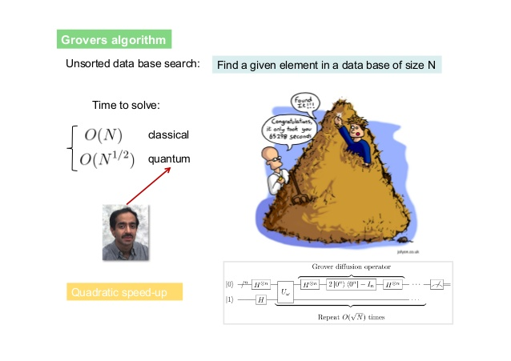
Grovers Algorithm

Slide 77
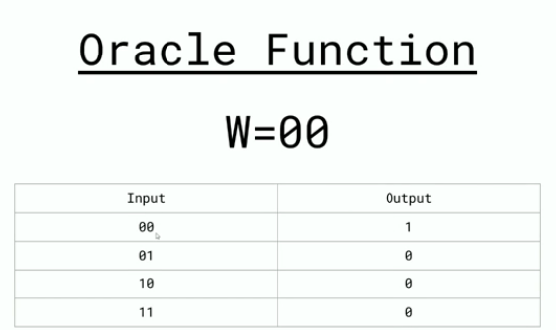
Back in 1996, an IIT Delhi and Stanford alumni — Lov Grover developed a quantum searching algorithm which had time complexity of O(√N). This is a revolutionary algorithm because analogous searching can’t be solved in less than O(N) with classical computing.

Slide 78
Entanglement https://youtu.be/OefsPBDOcFE
Quantum Entanglement defines the relation between two particles separated by a distance. This distance could be as small as one centimeter or thousands of light years. The relation is defined by the interaction between these two particles. For example, when two particles are entangled, one particle will be observed spinning upward, and the other particle will be spinning downward. This means that they possess properties correlating each other.
When the particles are not entangled, they possess individual identities. When they become entangled, they lose their individual identities. Now, they have a single identity that defines both of them. The interesting phenomenon is that any change in one particle reflects the effect in the other particle irrespective of the distance between them. Moreover, once the entanglement has been established, it will stay there irrespective of the distance. The particle seems to know about the other particle, even if they are separated by a large distance.

Slide 79
“Spooky Action At A Distance”
Regarding quantum entanglement, Albert Einstein called it “Spooky Action At A Distance”. One of the hypothesis could be that if the entangled particles experience changes instantly, even when they are separated by light years, there’s must be some unknown force traveling faster than light that instigates the changes in properties. Einstein rejected this explanation, as according to him, nothing could travel faster than light. There must be some unknown “local forces” that affects the entangled properties of these particles. According to him, particles possess “real” properties that are visible when we observe them.

Slide 80
Entanglement
One of QM’s most mystifying phenomena is quantum entanglement (Qe). According to this phenomenon, when two particles — such as atoms, photons, or electrons — are entangled, they experience an inexplicable link that is maintained even if the particles are on the opposite sides of the universe, a million light-years away. So, entangled means that the behavior of these particles is tied to one another. For example, if one particle is found spinning in one direction, then the other particle instantaneously and immediately changes its spin in a corresponding manner dictated by the entanglement. In fact, an observer measuring one particle could perfectly predict the corresponding measurements of a second observer looking at the other particle far away. In entanglement, one constituent (system or particle) cannot be fully described without considering the other(s). So far Qe has been demonstrated experimentally with photons, neutrinos, electrons, molecules as large as buckyballs and even small diamonds. Measurements of physical properties such as position, momentum, spin, and polarisation, performed on entangled particles have been found to be entangled.

Slide 81
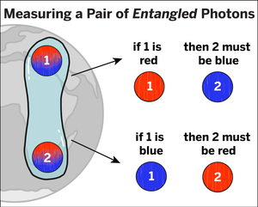
Entanglement
Entangled objects share a peculiar bond: When one member of an entangled collection is queried (that is, measured), its answer is always tightly linked, or correlated, to the answers of the other objects in the group. Scientists call the connection shared by entangled particles “entanglement.”
Entanglement is a rule that governs how measurements of one entangled partner relate to measurements of another.

Slide 82
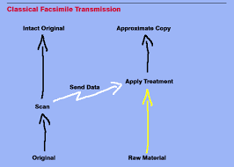

Slide 84
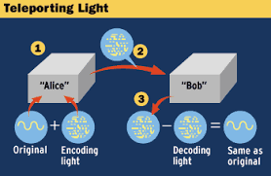

Slide 85
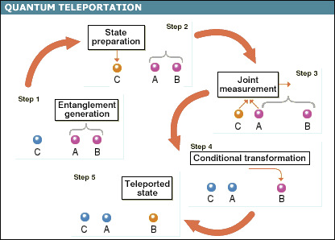

Slide 86
Quantum Computer
https://www.youtube.com/watch?v=HdSmIUuGf-I&list=PLtc7EtOn0ajEt_m03fGvSSfjtJLq58ezN&index=3&t=295s

Slide 87
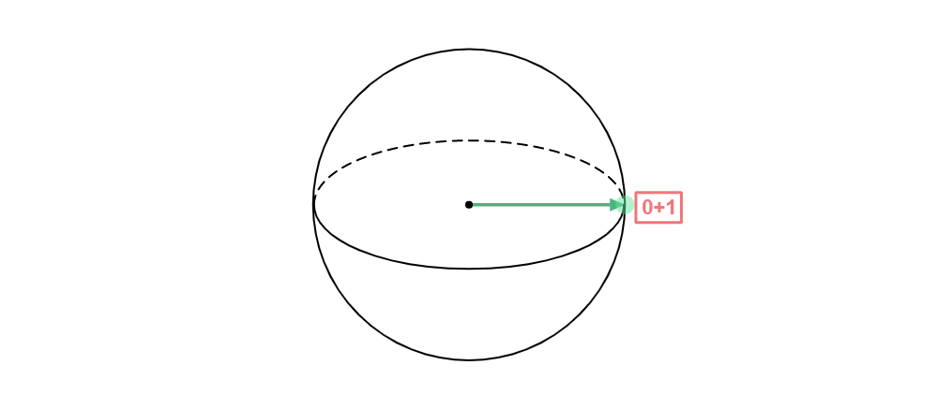
Quantum bits
The difference is much more than a name. Bits are like switches: They can be on or off, up or down, 0 or 1. Qubits, on the other hand, can take on an infinite number of different values—more like dimmer knobs than simple switches. Qubits can also store a superposition, which is akin to a switch that is both up and down at the same time.
Qubits are much more interesting. Instead of living in a space of just two points, qubits live on the surface of a sphere. Specifying the value of a qubit is just like specifying a location on the surface of the Earth. You provide a latitude and longitude, and this identifies a unique spot on an abstract globe.

Slide 88
Thus, measuring this algorithm’s output only yields the index of a probable output, which is called quantum Fourier sampling (QFS). QFS is an important primitive in quantum algorithms, and entails applying the QFT and measuring the output state, resulting in the sampling of an index i from a certain probability distribution.

Slide 89
Physical Implementation
Main Contenders
NMR (nuclear magnetic resonance)
Ion traps
Optical lattices
Quantum dots
Electrons on liquid helium
etc.
Main Deficiency
Poor scalability

Slide 90
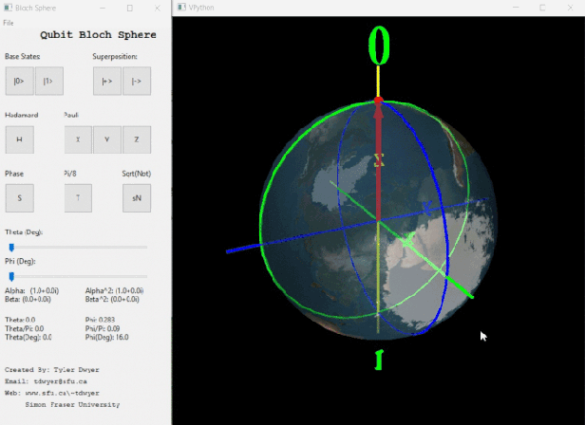

Slide 91
https://lahirumadushankablog.wordpress.com/2019/04/21/intro-to-quantum-logic-gates/

Slide 92
https://www.youtube.com/watch?v=Z1uoz_8dLH0&list=PL74Rel4IAsETUwZS_Se_P-fSEyEVQwni7
Umeshvazrani

Slide 93
Quantum machine leaning
CVSN Reddy
Dayananda Sagar University

Slide 94
Course contents – Classical Machine learning
What is machine learning
Features, Labels, Model
Supervised, Unsupervised, Reinforcement Learning
Overfit, Underfit, Optimumfit
Regression and Classification
Regression Algorithms
Classification Algorithms
Gradient descent, Learning rate
Tuning Machine Learning Algorithms

Slide 95
Course contents – Classical deep learning
What is deep learning
Perceptron and Mulipreceptron
DNN – supervised and Regression
RNN and LTSM
CNN
GAN
Tuning Deep Learning Algorithms

Slide 96
Course contents – quantum Machine learning
Regression Algorithms
Classification Algorithms
Gradient descent, Learning rate
Tuning Machine Learning Algorithms

Slide 97
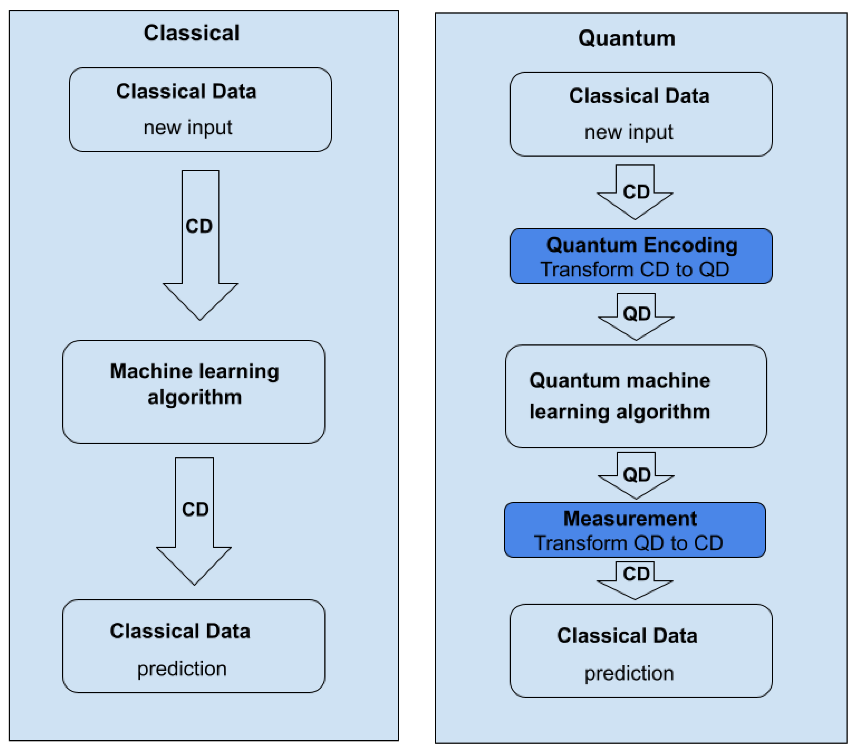
Quantum machine learing

Slide 98
Quantum Machine learning
https://www.youtube.com/watch?v=xgA4Dx_7q34&list=PLOFEBzvs-VvqJwybFxkTiDzhf5E11p8BI&ab_channel=Qiskit
IBM Training Material
https://github.com/qiskit-community/qiskit-community-tutorials/blob/master/machine_learning/vqc.ipynb(VVIP)
https://qiskit.org/documentation/machine-learning/tutorials/02_neural_network_classifier_and_regressor.html
IBM QNN for Regression and Classification
https://colab.research.google.com/drive/1bUGoWEA4SA5Qlx9gSipbDSCnm0LopCKy?usp=sharing
https://shubham-agnihotri.medium.com/quantum-machine-learning-102-qsvm-using-qiskit-731956231a54
ShubhamAgnihotri
https://www.datatobiz.com/blog/quantum-computing-concepts-and-implementation-in-python/
https://www.youtube.com/watch?v=A5QTukT1VS8&list=PLHgX2IExbFosaWB4cuGyal0pmS3gsI7je&ab_channel=AnalyticsIndiaMagazine(VVIP)

Slide 99
Shor algorithm
https://quantumcomputinguk.org/tutorials/shors-algorithm-with-code
Shor Algorithm from Quantum Computing UK
https://algassert.com/post/1718
Shor Algorithm explanation
https://davidbkemp.github.io/QuantumComputingArticle/
Interactive quantum computing explanation
https://learning.edx.org/course/course-v1:University_of_TorontoX+UTQML101x+2T2019/block-v1:University_of_TorontoX+UTQML101x+2T2019+type@sequential+block@a2696af4350747f9953dede5ec362132/block-v1:University_of_TorontoX+UTQML101x+2T2019+type@vertical+block@e67a77fd6f4a4b0e84ae4b2f74cfdefc
Quantum Machine Learning Course - EDX

Slide 100
https://pypi.org/project/qiskit-machine-learning/
QISKIT Machine learning tutorial
https://towardsai.net/p/programming/introduction-to-quantum-computing-with-python-and-qiskit-215f32e2e222
Quantum Gates
https://www.mit.edu/~aram/advice/quantum.html
https://learn.microsoft.com/en-us/azure/quantum/overview-algebra-for-quantum-computing

Slide 101
Grovers algorithm

Slide 102
HHL Algorithm

Slide 103
https://www.youtube.com/watch?v=23UXue7osZQ&ab_channel=AnastasiaMarchenkova
Best courses in quantum computing
https://www.youtube.com/watch?v=qCtB8S7VG8U&ab_channel=TylerDwyer
Bloch Sphere Animation
Quantum computer best books for babies…https://thequantuminsider.com/2020/05/15/7-quantum-computing-books-for-the-uninitiated/

Slide 104
Quantum circuit composer
https://quantum-computing.ibm.com/composer/docs/iqx/guide/introducing-qubit-phase

Slide 105
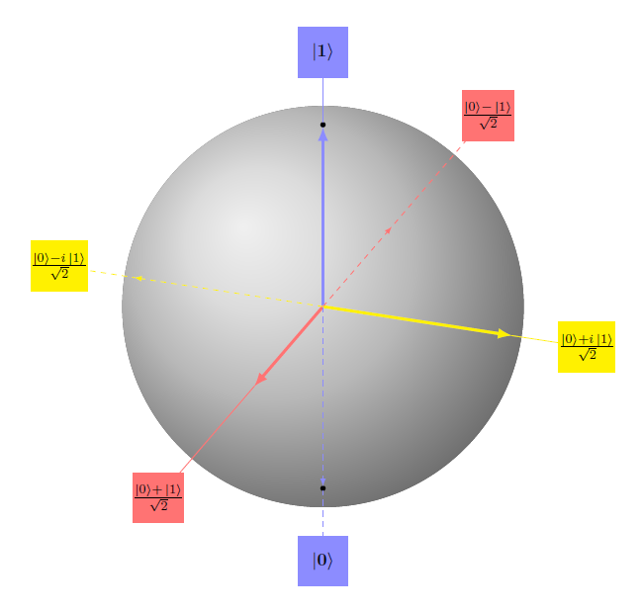

Slide 106
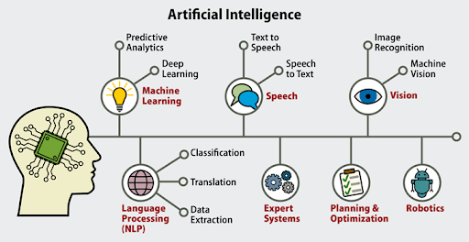

Slide 107
Industrial applications of qc
Quantum computing can be used to solve the challenges of optimization. Brands like Airbus, JP Morgan, and Daimler work on quantum computing and test their systems for better optimization. It can be implemented in various industries for an array of purposes. Let’s take a brief look at each:
Quantum computing is used in the automotive industry to optimize large autonomous fleets.
It is used in the energy industry to predict utilization, optimize the grids, and forecast weather.
It plays a role in the finance industry by automating trading, analyzing risk, managing portfolios, and detecting fraud.
Quantum computing in the insurance industry is used to evaluate the instruments and premiums in complicated cases/ claims.
It helps the supply chain and logistics industry with supply chain and inventory optimization.
In the manufacturing industry, quantum computing works on optimizing the designs of vehicles, chips, batteries, and other products.
It is used in the pharma industry to predict drug interaction and personalize medicines based on genomics.
In the technology/hardware software industry, quantum computing works with machine learning to speed up the learning process.

Slide 108
Leading qc companies
Industry | Companies
Automotive | Daimler, BMW, Volkswagen, Bosch, and Ford
Insurance | Fenox Venture Capital and JP Morgan
Logistics | Amazon and Ali Baba Group
IT/ Software | Amazon, Microsoft, IBM, Accenture, Google, Zapata Computing, and Honeywell
Finance | A&E Investments, Goldman Sachs, Airbus Ventures, Bloomberg Beta, Fenox Venture Capital, Alchemist Accelerator, Felicis Ventures, Amadeus Capital Partners, DCVC (Data Collective), and Entrepreneur First (EF)
Energy | Quix, Hitachi, Xanadu Quantum Technologies, Qunnect Inc, Raytheon BBN, Aegiq, and Alice &Bob
Pharma | D-Wave Solutions, IBM, and 1QBit

